Slide 1



Final Presentation
Nihon Study Guide
SEP490_G39

Slide 2
Nihon Study Guide
SEP490_G39
Final Presentation

Slide 3


Group member
1
2
3
Supervisor
Mr.
Nguyen Van Sang
4
5
6
Leader
Ngo Quoc Dat
HE163173
Member
Pham The Minh
HE171392
Member
Hoang Thai Son
HE163355
Member
Mai The Nam
HE161170
7

Slide 4
AGENDA
1
2
3
4
5
6
7

Slide 5

AGENDA
1
Project Overview
Project Management
2
3
Software Requirement Specification
Software Design
4
5
Testing
Project Result
6
7
Demo

Slide 6

Project overview
1
Project Overview
Project Management
2
3
Product Background
The Idea
Scope & Limitations
Software Requirement Specification
Software Design
4
5
Testing
Project Result
6
7
Demo

Slide 7

Project overview
Background
FPT Student Combo JS - Semester 6
3 months studying
Product Background
Scope & Limitations
The Idea

Slide 8



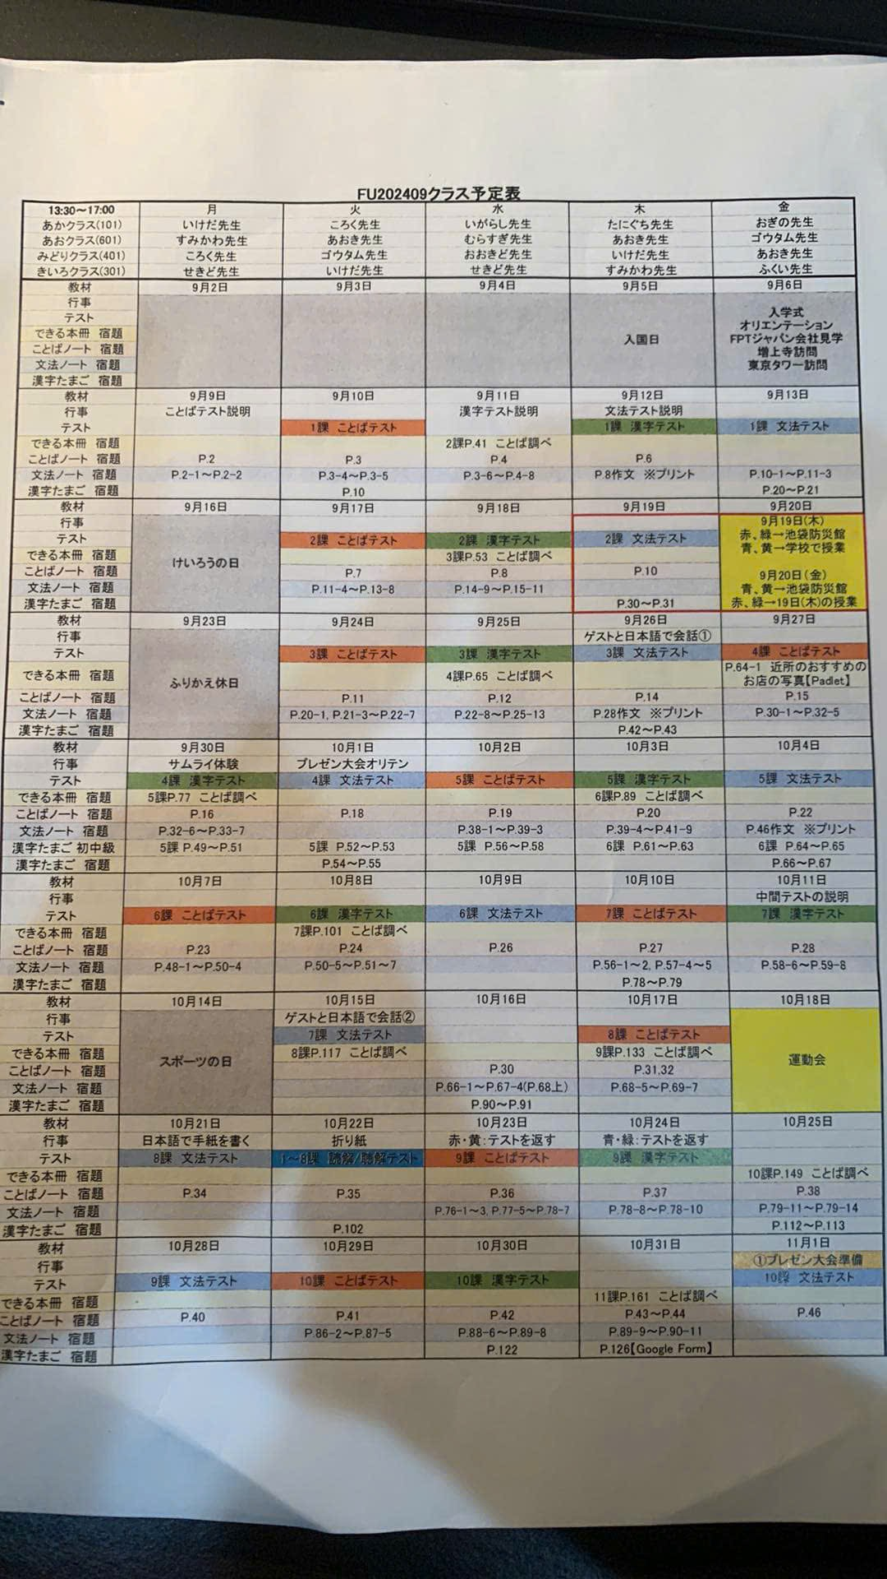
Project overview
Background
Information Channels
Announce news
Announce events
Track
schedule
Paper calendar

Slide 9

Project overview
Background
Paper calendar:
Easily lost
Difficult to track
Hard to deal with changes
Paper calendar

Slide 10
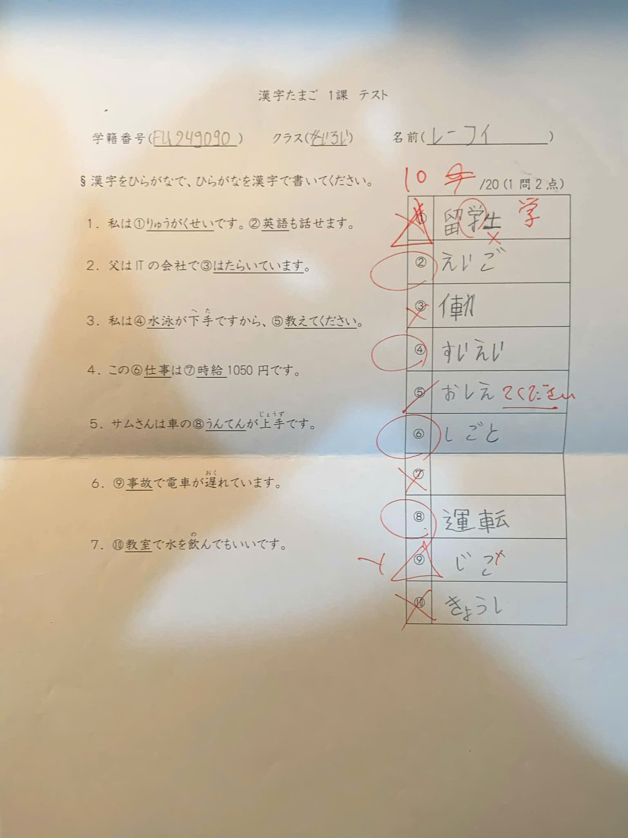
Project overview
Background
Daily exam:
Not systematized
Difficult to track
Difficult to calculate academic performance
Daily exam

Slide 11

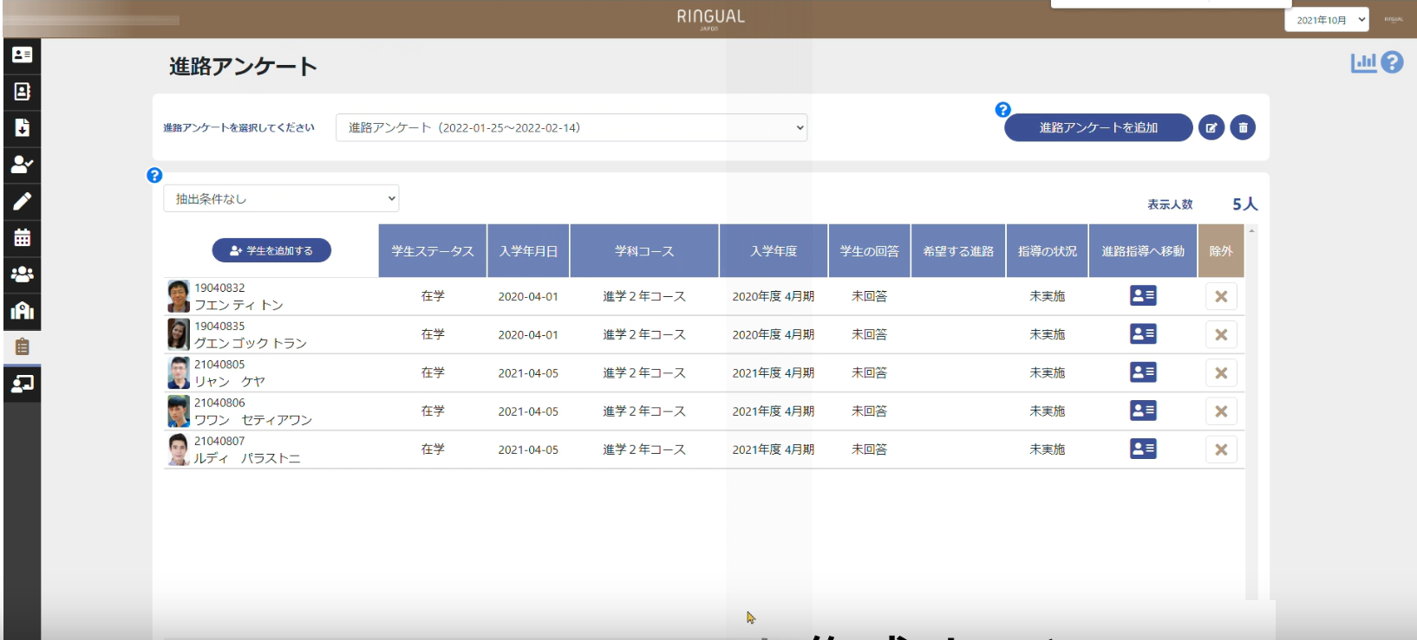

Project overview
Background
Existing system (Ringual Japon):
Support managing batches, teachers, students and attendance.
No students’ interface.
Do not support managing events and grades.
Do not manage learning materials.
Existing system

Slide 12

Project overview
The Idea
School management
Schedule tracking
Attendance management
Learning materials management
Systematize information channels
Grade tracking
Web Application

Slide 13
Project overview
Note: Other manage features
follow this model
Scope
Attendance management
Teacher management
Study management
General Access Control
View
report
Manage
attendance
Log in/Log out
Add
Disable
Add
Manage profile
News management
Modify
Manage
mark
Take attendance
View
View report
NSG Software
Feedback
Import
curriculum
Event management
Manage lesson
Set up schedule
Search
Manage class
Manage student
Create schedule
Import
Manage holiday
Manage exam
Batch management
Manage room, time slot
Curriculum management
Schedule management

Slide 14
Development Model
Project overview
Limitation
Project Risks
Team Structure
No mobile application support
No offline support
Lack of personalization
No disabilities support
No personal notes support
Tools & Infrastructure
Communication Plan

Slide 15
Project Management
Development Model
Project Risks
Team Structure
Tools & Infrastructure
Communication Plan

Slide 16
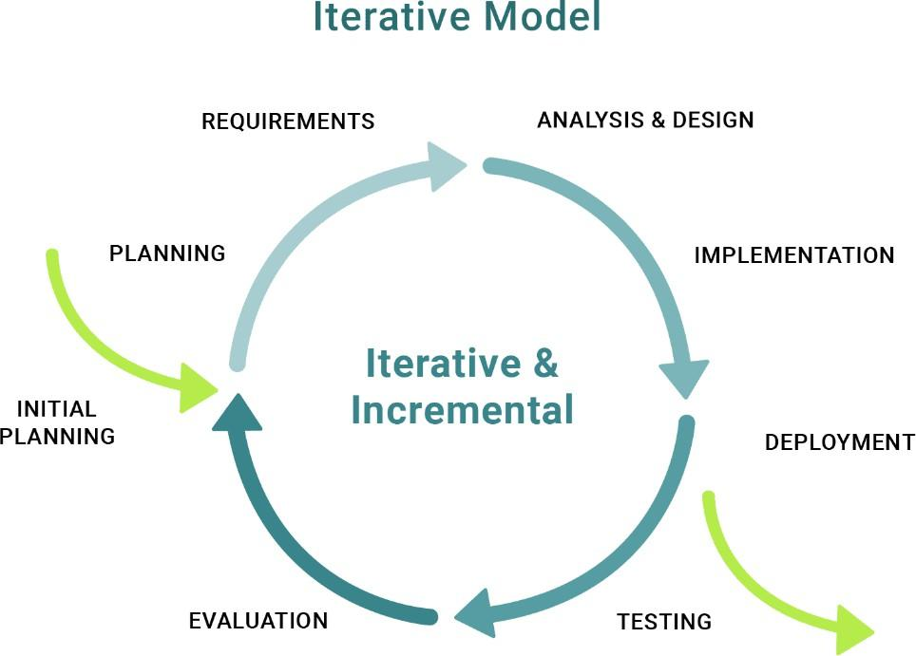
Project Management
Development Model

Slide 17
Project Management
Development Model
Requirements & Designing
Testing
Close
09/09/24
–
6/10/24
08/10/24
–
12/11/24
27/11/24
–
10/12/24
Initial Planning
06/10/24
–
08/11/24
Implementing
12/10/24
–
29/11/24
Transition
10/12/24
–
15/12/24

Slide 18


Project Management
Project Risks
Risk Description
Impact
Possibility
Response Plans
Create an effective work plan, divide the work for each person, and each person in the group needs to ensure that the divided work is completed on schedule.
The product is not completed according to schedule
High
Medium
Meeting with all members and lecturers, find out the causes and come up with solution ideas
Member conflict
Medium
High

Slide 19
Project Management
Team Structure
Supervisor
Nguyen Van Sang
Leader
Ngo Quoc Dat
Design Team
Development Team
Test Team
Business Analysis
UI Design
Front-end
Back-end
Hoang Thai Son
Pham The Minh
Mai The Nam
Pham The Minh
Pham The Minh
Ngo Quoc Dat
Mai The Nam
Ngo Quoc Dat
Hoang Thai Son
Pham The Minh
Ngo Quoc Dat
Mai The Nam
Hoang Thai Son

Slide 20
Hoang Thai Son
UI Design
Development Team
Hoang Thai Son
Pham The Minh
Ngo Quoc Dat
Project Management
Communication Plan
Supervisor
Nguyen Van Sang
Communication Items
Who/Target
Purpose
When/Frequency
Type, Tool, Method(s)
Leader
Ngo Quoc Dat
Daily meeting
Team member
Report tasks.
Raise problems.
Everyday (20:30 – 20:45)
Discord
Assign tasks
Team member
Leader assigns tasks to other team members.
Once a week
Discord
Design Team
Meeting with supervisor
Team member, supervisor
Checking progress of project. Plan upcoming tasks.
Update requirements.
Once a week (Every Wednesday)
Google Meet, Campus
Front-end
Team member, supervisor
Review tasks.
Check the progress of tasks in the sprint.
Support for hard problems
Every Wednesday and Sunday from 20h - 23h30
Weekly meeting
Discord
Pham The Minh
Mai The Nam
Pham The Minh
Ngo Quoc Dat
Additional meeting
Anytime a team member has problems.
Team member
Solve issue
Discord
Mai The Nam
Business Analysis
Pham The Minh
Ngo Quoc Dat
Mai The Nam
Back-end
Test Team
Hoang Thai Son

Slide 21












Project Management
Tool & Infrastructures
Tool & Infrastructures
Category
Tool/Infrastructure
Framework
Vue.js
Spring Boot
Database
MySQL
IDEs/Editor
Intellij IDEA
Visual Studio Code
Version Control
GitHub
Design
Figma
Visual Paradigm
Documentations
Google Docs
Google Sheets
OneDrive
Project Management
Google Sheets
Discord

Slide 22
Software requirement
Use Case Diagrams
Screens Flow
Entity Relationship Diagram
Non-functional Requirements

Slide 23
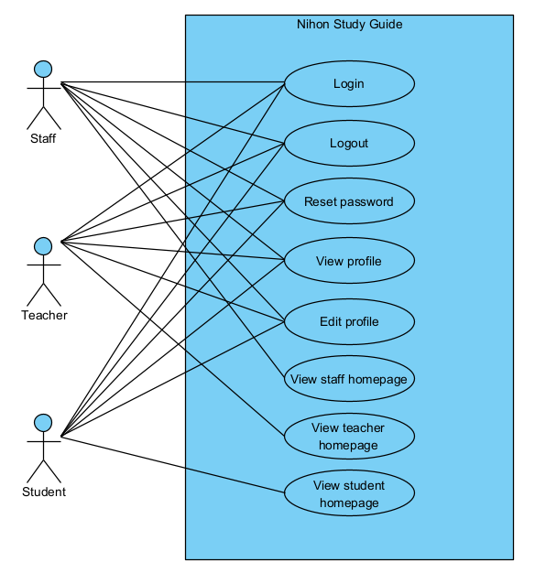
Software requirement
Use cases diagrams
General access control

Slide 24
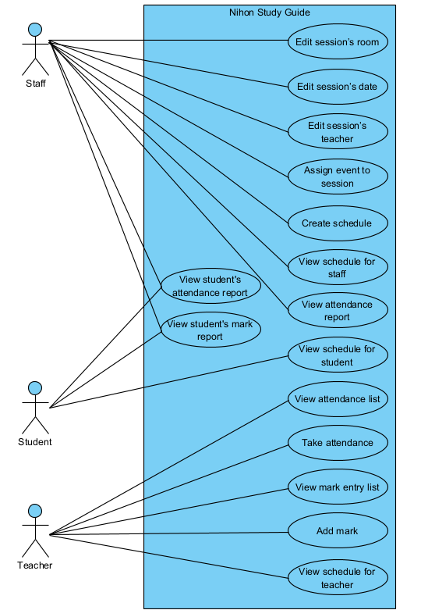
Software requirement
Use cases diagrams
Student management
Mark management
Attendance management

Slide 25
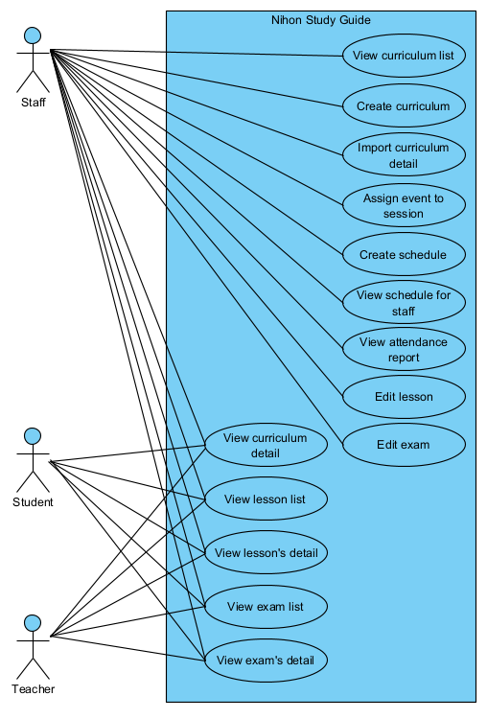
Software requirement
Use cases diagrams
Curriculum management
Lesson management
Exam management

Slide 26
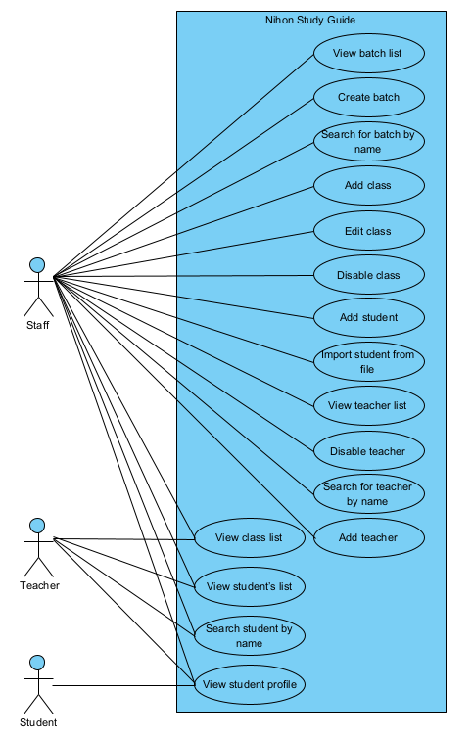
Software requirement
Use cases diagrams
Batch management
Class management
Student management
Teacher management

Slide 27
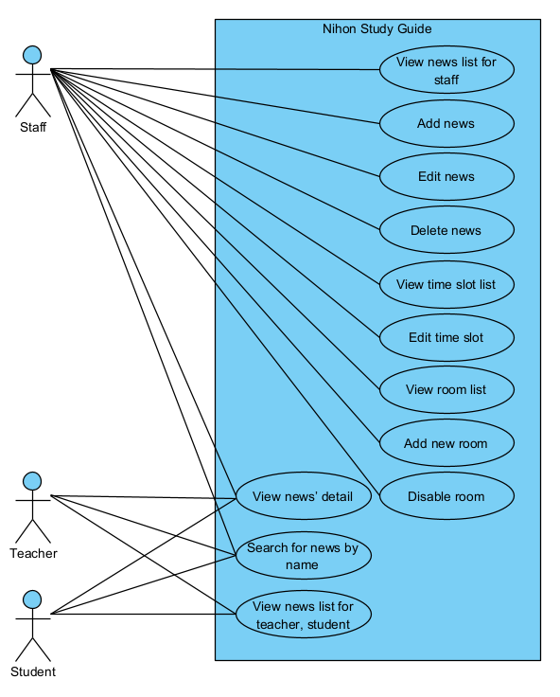
Software requirement
Use cases diagrams
News management
Time slot management
Room management

Slide 28
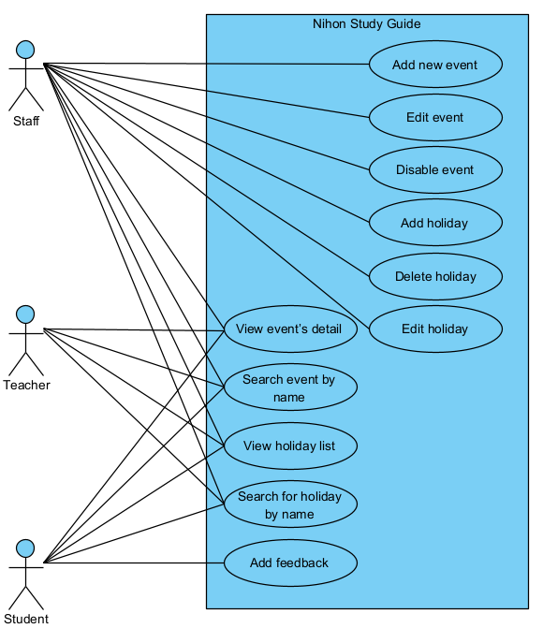
Software requirement
Use cases diagrams
Event management
Holiday management

Slide 29
Teacher record
Software requirement
Holiday list
Screens flow
News list
Create news
Staff
Schedule management
News detail
Attendance report
Student’s attendance report
Mark report
Student’s mark report
Login
Staff homepage
Batch list
Batch detail
Event list
Event detail
Room list
Reset password
Student list
Student profile
Class list
Import student
Time slot list
Exam’s detail
Curriculum list
Curriculum detail
Import curriculum
My profile
Lesson’s detail

Slide 30
Software requirement
Screens flow
Teacher
News list
News detail
Teacher’s schedule
Attendance management
Take attendance
Mark entry management
Add mark
Login
Teacher homepage
Holiday list
Event list
Event detail
Reset password
Student list
Student profile
Class list
Exam’s detail
Curriculum
Curriculum detail
My profile
Lesson’s detail

Slide 31
Software requirement
Screens flow
Student
News list
News detail
Student’s schedule
Attendance report
Mark report
Login
Student homepage
Holiday list
Event list
Event detail
Reset password
Class’s member
Student profile
Exam’s detail
Curriculum
Curriculum detail
Lesson’s detail

Slide 32
Software requirement
Screens flow
Admin
Reset password
Account Management
Login
Attendance Management
Mark Management

Slide 33
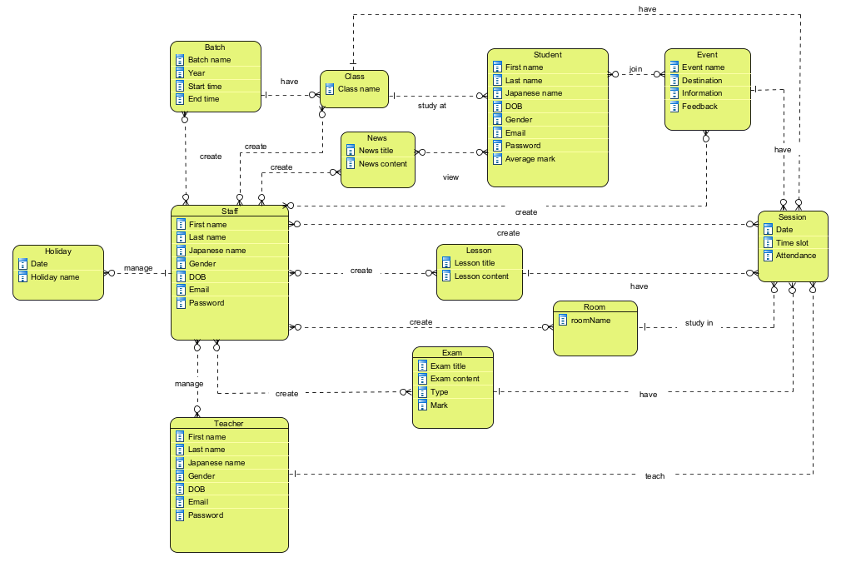
Software requirement
Entity Relationship Diagram

Slide 34


Software requirement
Non-functional Requirements
Security
Implements role-based access control to ensure that only authorized users can access specific functions and data.
Usability
Clear and intuitive navigation
User-friendly interface
Efficient task completion

Slide 35






System Architecture
Software Design
Package Diagram
Database Design
Class Diagram
Sequence Diagram

Slide 36



Software DESIGN
System Architecture
Browser
Front-end (Vue.js)
Package Diagram
Interact
View
DOM Listeners
Model
Database Design
Directives
Send mails
HTTP Response
HTTP Request
Class Diagram
Spring Boot
Request
Back-end
DTO
Rest API Controller
Sequence Diagram
Spring Data JPA
Repository
Service
Database
Entities
36

Slide 37
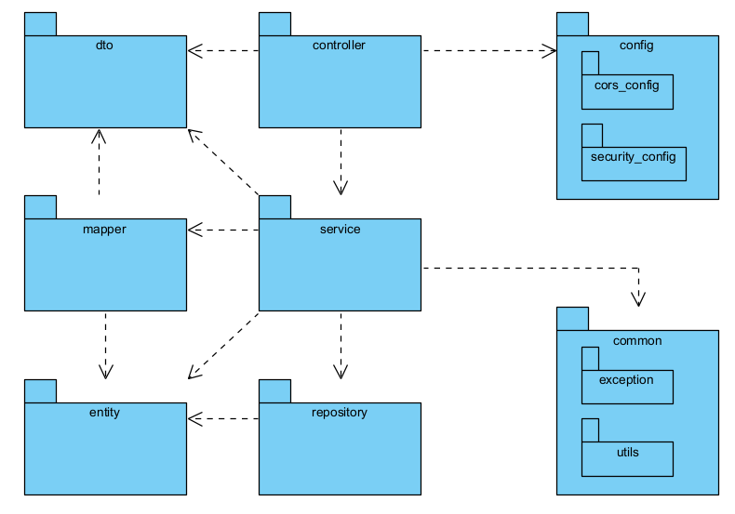
Software DESIGN
Package Diagram

Slide 38
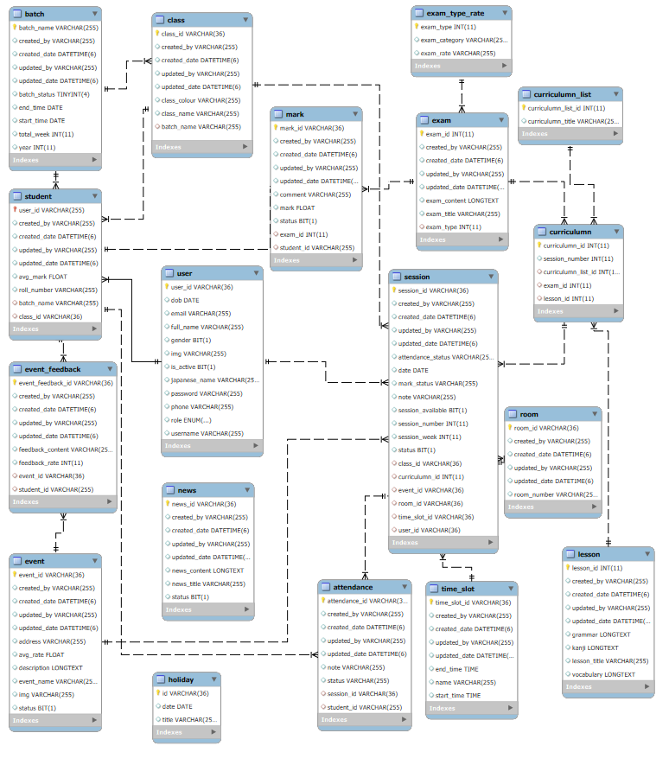
Software DESIGN
Database Design

Slide 39
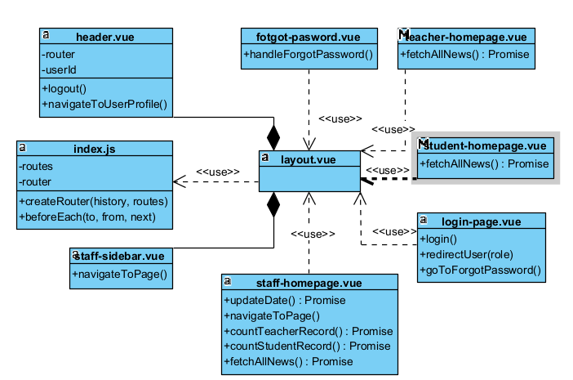
Software DESIGN
Class Diagram
Front-end

Slide 40
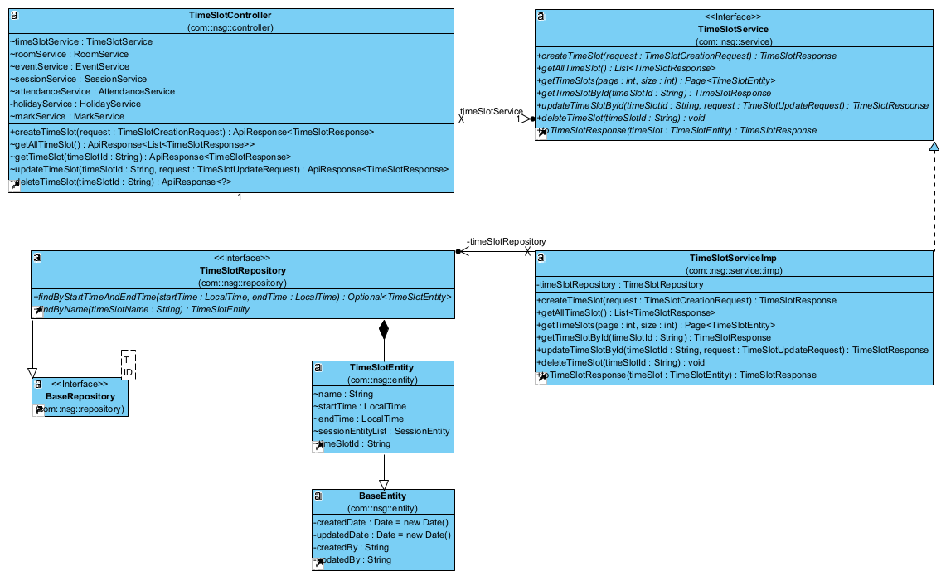
Software DESIGN
Class Diagram
Back-end

Slide 41
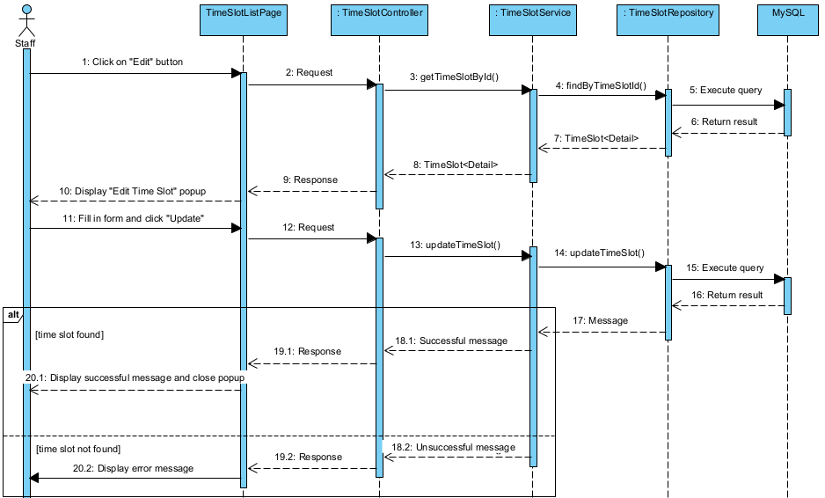
Software DESIGN
Test Stage
Sequence Diagram
Test Cases
Test Model
Test Report
Test Milestone

Slide 42
Software Testing
Test Stage
Test Cases
Test Model
Test Report
Test Milestone

Slide 43
Software Testing
Test Stage
Test Cases
Test Model
Test Report
Test Milestone

Slide 44
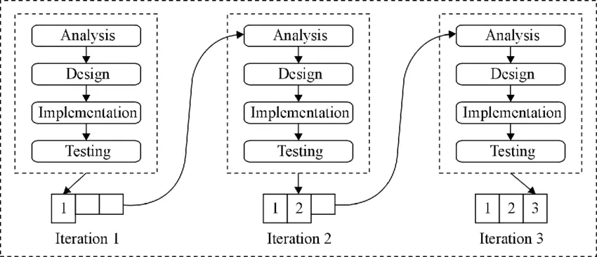

Software Testing
Test Model

Slide 45
Software Testing
Test Stage
Test Level
Type of Tests
Unit
Integration
System
Unit Testing
X
X
X
Function Testing
X
X
X
API Testing
X

Slide 46
Software Testing
Test Milestone
Milestone Task
Start Date
End Date
Test Plan
16/09/24
23/09/24
Unit Test
12/10/24
22/10/24
Integration Test
22/10/24
01/11/24
System Test
01/11/24
15/11/24

Slide 47
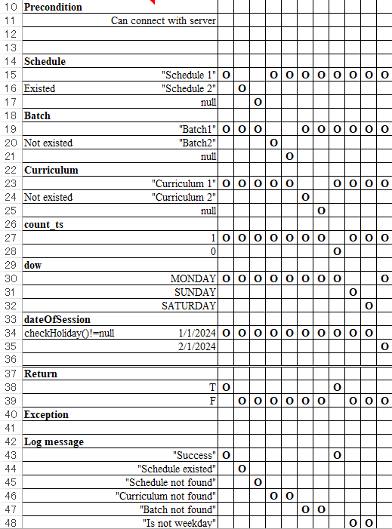
Software Testing
Test Cases
Unit Test

Slide 48
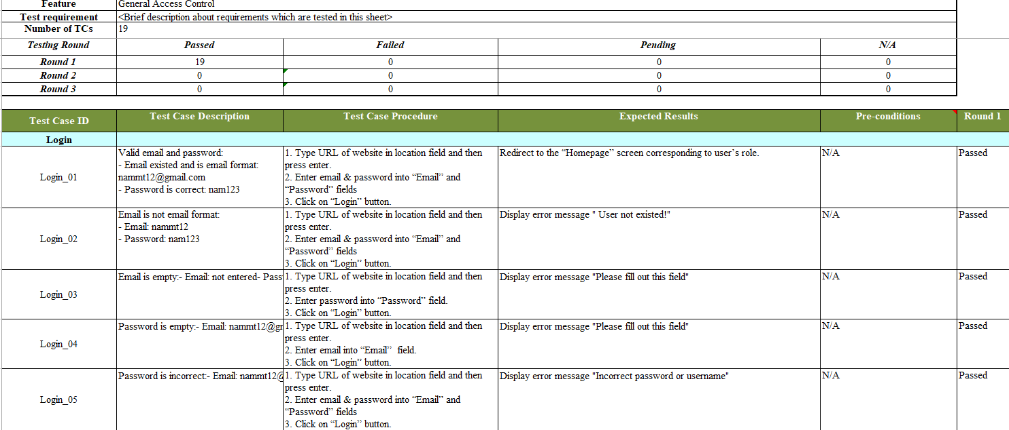
Software Testing
Test Cases
Integration Test

Slide 49
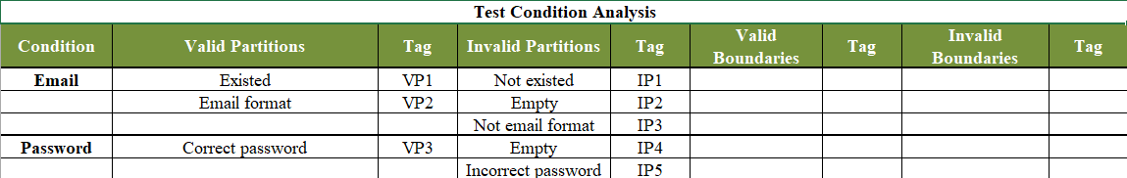
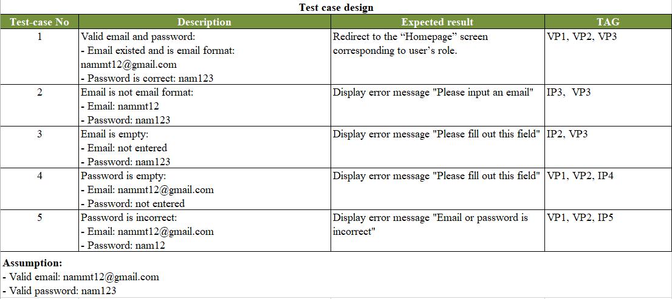
Software Testing
Test Cases
Integration Test

Slide 50
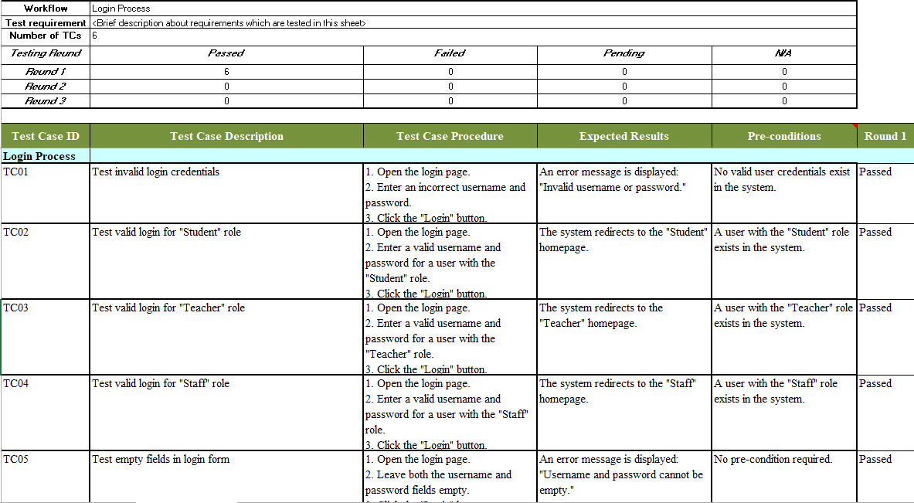
Software Testing
Test Cases
System Test

Slide 51
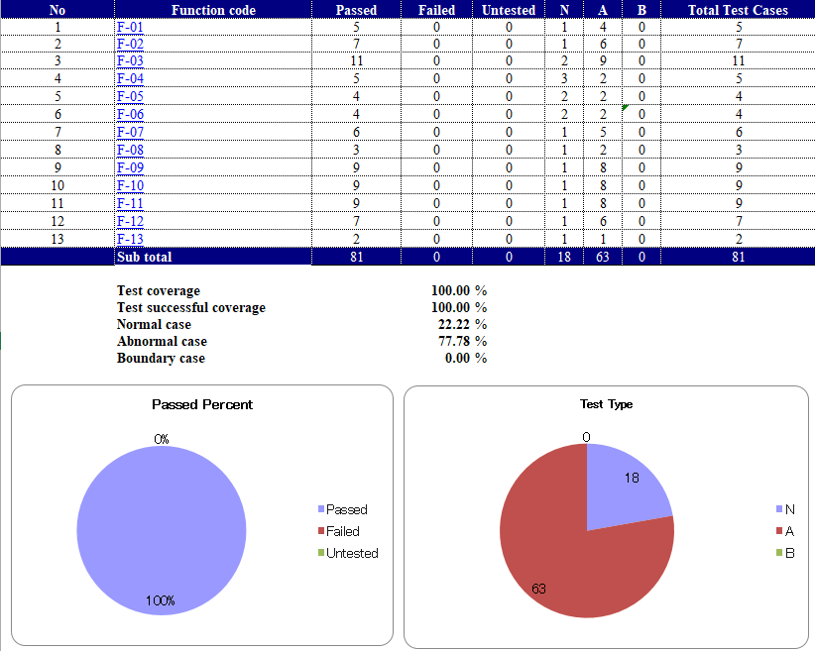
Software Testing
Test Report
Unit Test

Slide 52
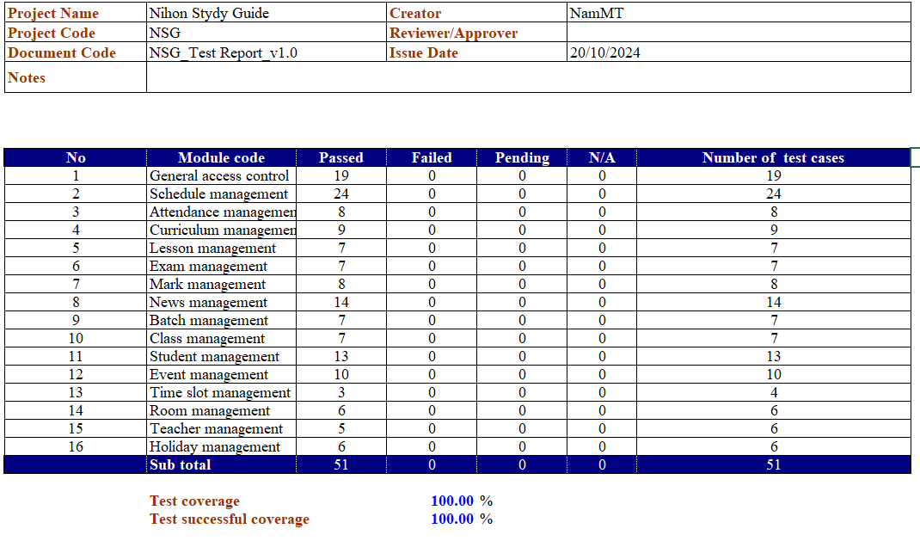
Software Testing
Test Report
Integration Test

Slide 53

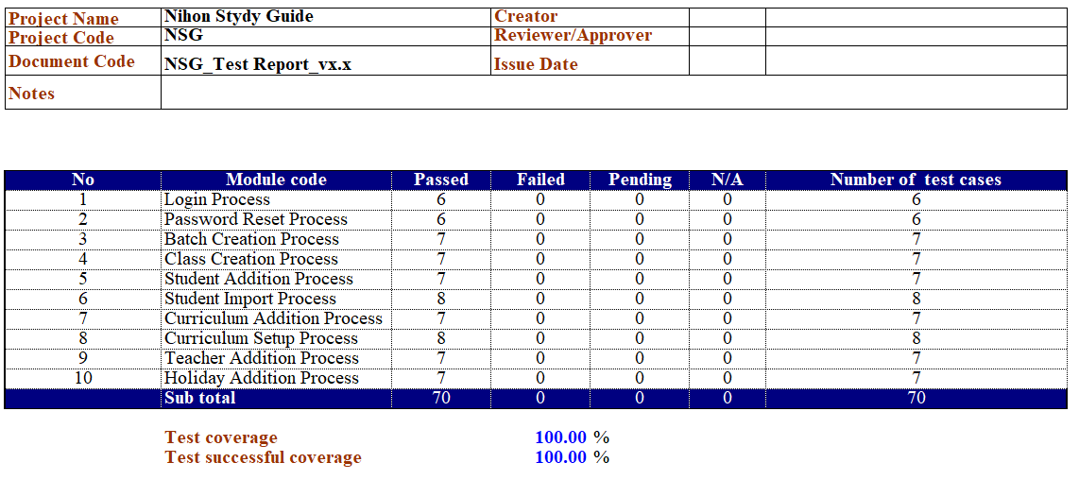
Software Testing
Test Report
System Test

Slide 54
Summarize
Project Result
Limitation & Expectation
Lesson Learned

Slide 55
Summarize
Project Result
Completed basic functions
Has more experiences and skills
Soft skill
Management skill
Technical skill

Slide 56

Summarize
Limitation & Expectation
Limitations
Expectation
Haven’t finished all functions as expected.
Do not build mobile application.
Improve efficiency.
Develop all planned functions.
Develop mobile application.
Put the system in real life.

Slide 57

Summarize
Lesson Learned
Situation
Problem
Lesson Learned
Improve consciousness
Support each other
Lazy during the first period
Miss deadline, overwhelmed
Listen
Analysis
Members’ conflict
Stress, no common voice
Be flexible
Have back-up plan
Lack of human resources
Member left team
DEMO

Slide 58
DEMO

